Slide 1
AES Benchmarking
on the Raspberry Pi 4
Characterizing software AES across key sizes and modes of operation
on an ARM Cortex-A72
Dhruv Bhatnagar
Waamiq Sharrar
Mikael Parsamyan
Parsa Ghasemi

Slide 2
Explaining AES
AES is a block cipher. It always operates on fixed 16-byte blocks, regardless of key size, by arranging them as a 4×4 grid of bytes called the state and running it through several rounds of four fixed operations.
EXAMPLE INPUT
ROUNDS
"HELLO WORLD, THI"
1
SubBytes
16 bytes → arranged as 4×4 state
Each byte is replaced via a 256-entry lookup table (the S-box). The only nonlinear step — makes algebra attacks fail.
10
48
4F
52
20
ShiftRows
AES-128
2
45
20
4C
54
Rows of the grid slide sideways by 0/1/2/3. Spreads bytes across columns.
12
3
MixColumns
4C
57
44
48
Each column is multiplied by a fixed matrix in GF(2⁸). Spreads influence within columns.
AES-192
4C
4F
2C
49
4
AddRoundKey
14
A 16-byte round key is XOR-ed into the state. The only step that touches the key.
AES-256

Slide 3
Modes of Operation
AES only encrypts 16 bytes at a time. A mode of operation is the rule for how you chain many AES calls together to encrypt a longer message.
CBC
CTR
GCM
Cipher Block Chaining
Counter Mode
Galois / Counter Mode
THE RULE
THE RULE
THE RULE
Each block is XORed with the previous block's ciphertext before being encrypted.
Encrypts an incrementing counter (1, 2, ...) and XORs the result with the plaintext.
Runs CTR encryption, then computes a GHASH authentication tag over the ciphertext.
HOW IT WORKS
HOW IT WORKS
HOW IT WORKS
Block 1 starts with a random IV (initialization vector) since there is no previous block.
Block N must wait for block N−1 to finish before it can begin.
Result identical plaintext blocks always encrypt to different outputs, patterns are hidden.
Start with a nonce, which is 12 bytes and then || the counter you are on, which gives counter blocks
Run AES on counter blocks to create key stream, all key streams can be created at once
XOR each keystream with the corresponding plaintext block
Encryption is identical to CTR. same parallel structure, same speed potential.
Tag is a 16-byte seal that detects tampering (AES applied to a block of all zeros.).
Run GHASH over the ciphertext blocks
Encrypt counter block 0 and XOR it with the fingerprint to produce the final TAG.
Sent over wire:
Sent over wire:
Sent over wire:
IV + C1 + C2 + C3
nonce + C1 + C2 + C3
nonce + C1 + C2 + C3 + TAG

Slide 4
Hardware Setup
DEVICE UNDER TEST
POWER
DC Bench Supply
Raspberry Pi 4 Model B
Constant 5.0 V feed with live current and voltage monitoring, lets us correlate workload to power draw and confirm the board is not browning out under load.
SoC | Broadcom BCM2711
CPU | Quad-core ARM Cortex-A72 (ARMv8-A, 64-bit)
Clock | 1.5 GHz (base)
Crypto ext. | Not present (OPENSSL_armcap = 0x81)
L1 cache | 32 KB I + 32 KB D per core
L2 cache | 1 MB shared
RAM | LPDDR4
OS | Raspberry Pi OS (Debian-based, 64-bit)
COOLING
Active CPU Fan
Prevents thermal throttling during sustained runs. Measured range across all nine benchmarks: 43.3 °C → 61.8 °C. Pi 4 throttles at ~80 °C, so results are not contaminated.

Slide 5
Software Stack & Versions
Every benchmark run reports the OpenSSL build details and compiler flags. The stack below was held constant across all nine runs, so no package changes, no reboots, no alternate toolchains, no mismatched versions. Therefore, any differences in the data come from the actual benchmark itself.
COMPONENT | VERSION | ROLE
Raspberry Pi OS | 64-bit, Debian 12 (Bookworm) | Host operating system
Linux kernel | aarch64 | perf_event subsystem / cycle counters
OpenSSL | 3.0.19 | Secure Sockets Layer, with dedicated algorithm testing tools
perf | 6.12.75 | Linux profiler to get cycles and instructions
perf-event-paranoid | -1 value instead of 1 or 2 | Enables full access to capture kernel-level data
vcgencmd | Raspberry Pi firmware utility | CPU temperature probe between runs
Python | 3.11.2 | Exact version used for our code

Slide 6
Additional Measures + Features
COMPONENT | VERSION | ROLE
INA219 Current/Voltage Meter | INA219 Off-Board Chip | Curious to see power readings in between tests (NOT DURING)
Power Supply | Stable +5V | D.C Power Supply Used to Ensure Constant Voltage
Raspberry Pi Fan | +5V <200mA | Repeated tests with&without proved the fan was helpful for temps

Slide 7
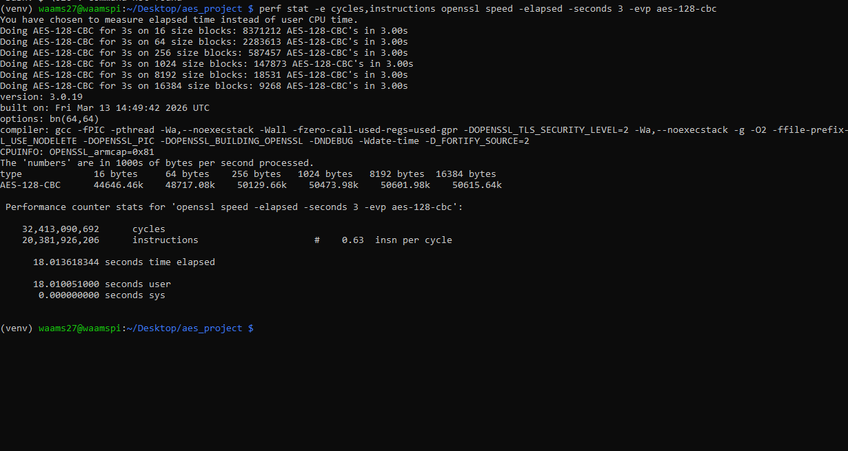
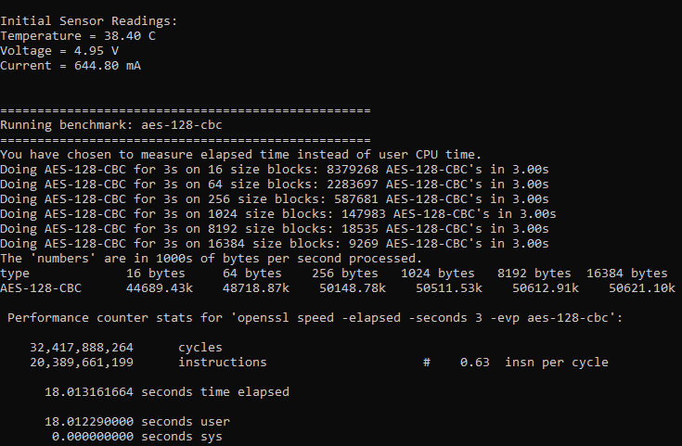
Raw Benchmark Output
Representative session — one run per (key size × mode). Each invocation is wrapped in perf stat to capture cycles and instructions alongside OpenSSL's throughput table. i.e AES-128-CBC. The pictures below show two different runs using same command, the picture on the right provides more data as it is output from our script

Slide 8
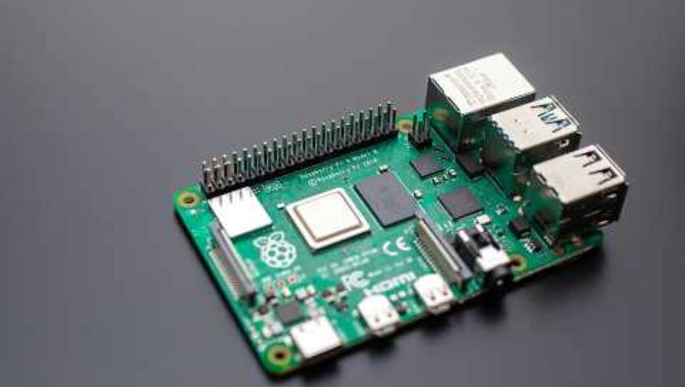
Demonstration
Link: www.youtube.com/watch?v=4sEZqdryVMg&feature=youtu.be

Slide 9
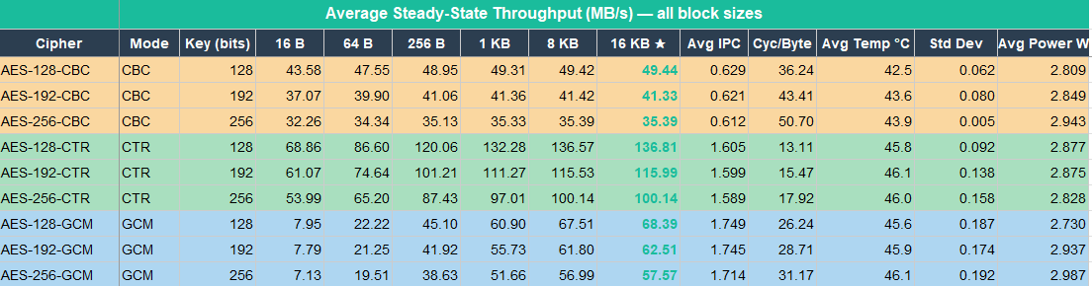
Throughput Data (MB/s)
All nine AES configurations across OpenSSL's six standard block sizes. Values converted from OpenSSL's kB/s output. Largest block column (16 KB) is the steady-state throughput — smaller blocks pay per-call overhead.

Slide 10
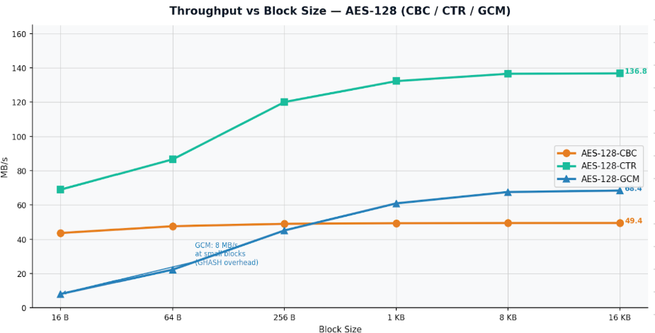
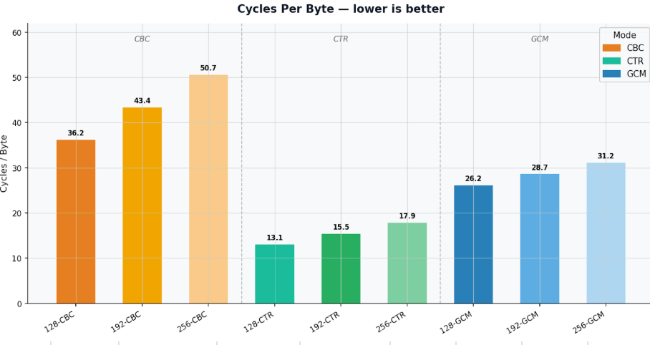
Visualized
IPC (instructions per cycle, A72 max ≈ 3)
0.63
0.62
0.61
1.61
1.60
1.76
1.75
1.72
CBC-128
CBC-192
CBC-256
CTR-128
CTR-192
GCM-128
GCM-192
GCM-256

Slide 11
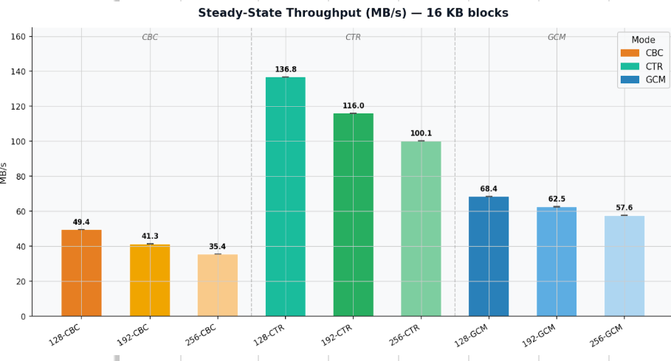
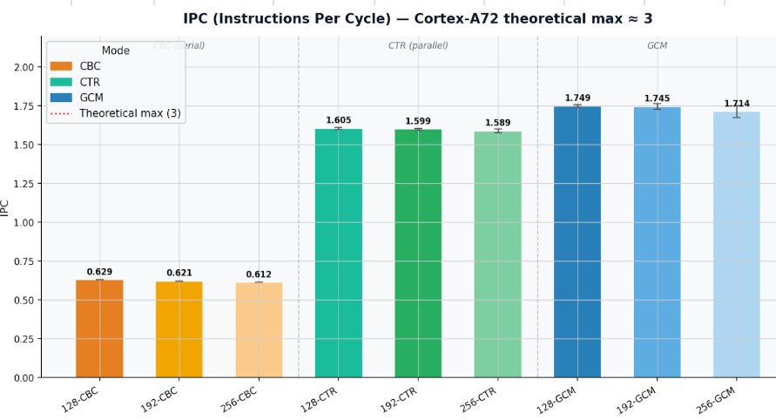
Visualized
IPC (instructions per cycle, A72 max ≈ 3)
0.63
0.62
0.61
1.61
1.60
1.76
1.75
1.72
CBC-128
CBC-192
CBC-256
CTR-128
CTR-192
GCM-128
GCM-192
GCM-256

Slide 12
Analysis I. Key Size Scales With Rounds
AES-128 → AES-256 costs roughly 28 % throughput.
KEY SIZE | ROUNDS | PREDICTED RATIO | OBSERVED (CBC) | OBSERVED (CTR) | OBSERVED (GCM)
AES-128 | 10 | 1.00 (baseline) | 1.00 | 1.00 | 1.00
AES-192 | 12 | 0.833 (10 / 12) | 0.840 | 0.845 | 0.913
AES-256 | 14 | 0.714 (10 / 14) | 0.716 | 0.729 | 0.841
CBC and CTR match theory
GCM decays more slowly
The CBC and CTR ratios land within 2 % of the predicted 10/12 and 10/14 ratios. The CPU spends its time exactly where the round function says it should, every extra round is a real, measurable cost.
GCM's ratios (0.91, 0.84) are higher than 10/12 and 10/14. GHASH does not get more expensive with bigger keys, so it dilutes the round-count penalty. The extra rounds are still there, they are just a smaller share of GCM's total work.

Slide 13
Analysis II. The Modes
Changing the mode of operation moves throughput by up to 3×, far more than changing the key size. IPC shows the A72 pipeline is idle more than half the time in CBC and busier in CTR/GCM.
50.6
140.1
69.9
MB/s
MB/s
MB/s
AES-128-CBC
AES-128-CTR
AES-128-GCM
IPC 0.63
IPC 1.61
IPC 1.76
CBC is serially chained. Block N+1 cannot start until block N's ciphertext is written, so the Cortex-A72's out-of-order pipeline has nothing to schedule in parallel. IPC collapses to 0.63, the core is idle more than half the time.
CTR encrypts an independent counter for every block.
All blocks can be computed in parallel, so the pipeline fills up. IPC rises to 1.61, and throughput jumps to 140 MB/s the same AES math, just reorganized.
GCM = CTR + GHASH.
The counter half parallelizes like CTR (IPC even higher at 1.76), but GHASH runs in software because the Pi 4 has no PMULL instruction. That software fallback roughly halves CTR's throughput giving GCM a middle result of ~70 MB/s.
9

Slide 14
Thank you.

